Slide 1

SECURE INNOVATIVE VOTING SYSTEM WITH BIOMETRIC AND OTP AUTHENTICATION
G Pullaiah college of engineering and technology
(An Autonomous Institute affiliated to JNTUA, Ananthapur)
By Team A12
Team members:
Syed Noorullah Basha (21AT5A3507)
Bachu Guru Jashwanth (20AT1A3512)
Vadla Jaswanth Achari (20AT1A3518)
Muhammad Imaad Ul Haq (20AT1A3517)
Guided By:
Mrs. N. S. Swapna
(Assistant Professor)
Head of Department:
Dr. P. Suman Prakash M.Tech, Ph.D.
Project Coordinator:
Dr. C. Veena P.hd

Slide 2

ABSTRACT
Our project introduces a Secure Voting System with Biometric and OTP Authentication to enhance voting security and efficiency.
It utilizes biometric technology and mobile communication for secure voter authentication. The system aims to address identity verification challenges and prevent fraud in traditional voting methods.
By combining fingerprint recognition and OTP authentication, it ensures reliable and trustworthy election procedures.

Slide 3

LITERATURE SURVEY
The realm of biometric authentication, particularly emphasizing the effectiveness of fingerprint recognition systems in enhancing the security of voting procedures. Additionally, it highlighted the importance of OTP authentication as an additional layer of security to strengthen the integrity of the voting process. These findings laid the groundwork for our project's development, offering valuable insights into cutting-edge technologies and methodologies in the electoral systems domain.

Slide 4
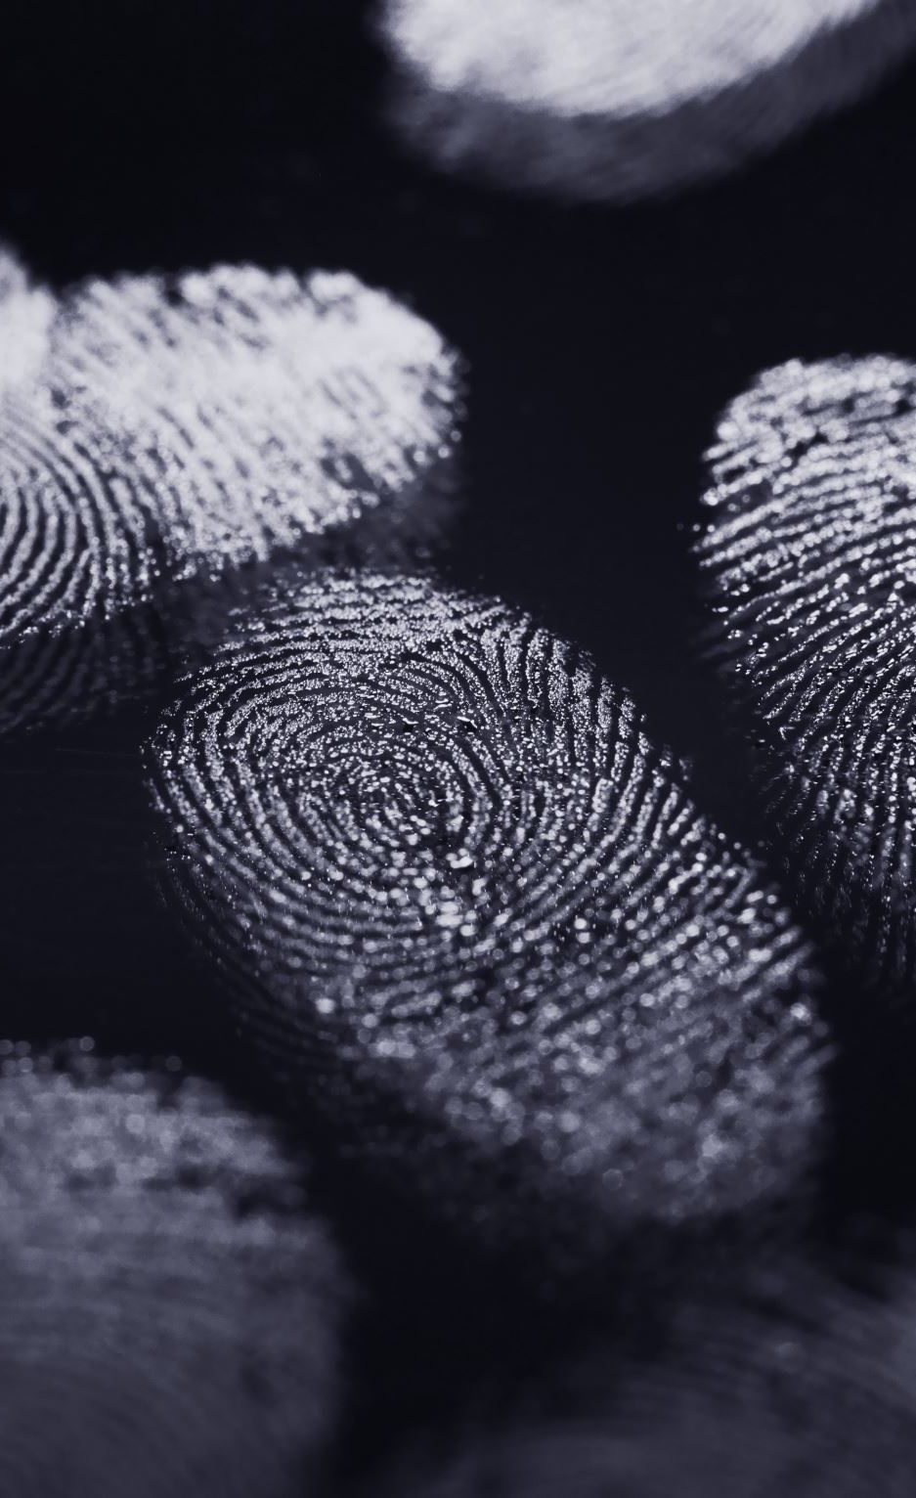
INTRODUCTION
Introducing our project: the Secure Innovative Voting System with Biometric and OTP Authentication. It's a pioneering solution aimed at enhancing electoral security and efficiency. By leveraging biometric fingerprint recognition and GSM communication, we're redefining the voting process to ensure reliability and integrity.

Slide 5

EXISTING MODEL
The existing methods relies on conventional Electronic Voting Machines (EVMs) in India's elections. However, it faces challenges like insufficient authentication and susceptibility to fraud, such as booth capturing, rigging, and fake voting.
In the existing model, there exists a fingerprint-based voting system, aiming to authenticate voters. However, it lacks effective authentication methods, leaving it vulnerable to manipulation and forging of duplicate fingerprints. This limitation poses significant challenges to ensuring the integrity and security of the electoral process.

Slide 6
LIMITATIONS OF EXISTING MODEL
Insufficient authentication methods: Existing systems often rely on outdated or inadequate authentication methods, leading to concerns regarding the integrity of voter identities.
Vulnerability to manipulation: Traditional voting systems are susceptible to various forms of manipulation, such as booth capturing and rigging, which undermine the fairness and transparency of the electoral process.
Security risks: The reliance on fingerprint-based authentication alone poses security risks, as these systems can be compromised through the forging of duplicate fingerprints, potentially allowing unauthorized individuals to cast votes.

Slide 7

PROPOSED MODEL
The proposed smart voting system integrates biometrics-based fingerprint authentication and OTP (One-Time Password) verification to ensure a secure and efficient voting process. Voters authenticate themselves using their fingerprints, enhancing identity integrity.
Registration involves providing personal information and biometric data, securely stored in the System. During voting, voters authenticate using their fingerprints, verified against registered data.
Additionally, OTP authentication enhances security. After fingerprint authentication, voters receive a one-time password on their registered mobile devices, which they must enter to validate their identity and cast their votes.

Slide 8
ADVANTAGES OF PROPOSED MODEL
Enhanced security: Biometric authentication and OTP verification add layers of security, reducing identity fraud risks.
Real-time authentication: Enables immediate verification of voter identities.
Swift response: Immediate alerts allow rapid action against irregularities.
Improved efficiency: Automates authentication, streamlining the voting process.
Restoration of trust: Addresses system shortcomings, ensuring fair elections.

Slide 9
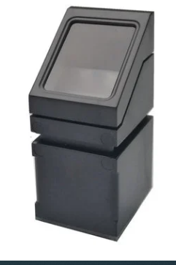
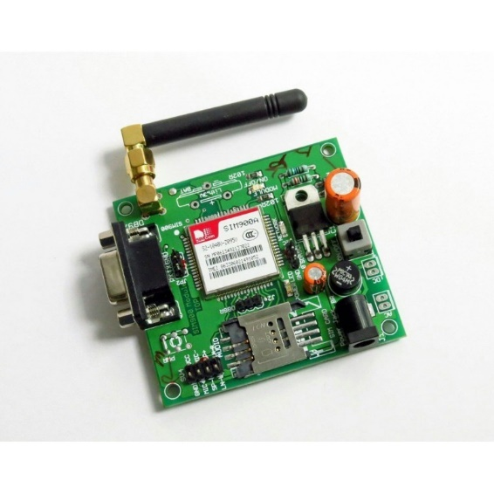

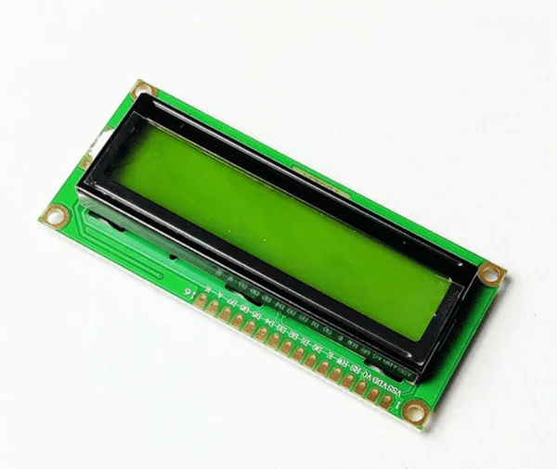
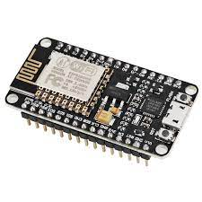
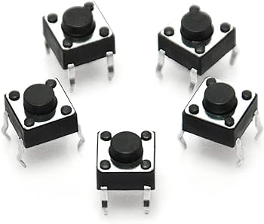
SYSTEM REQUIREMENTS
FINGERPRINT SENSOR
ARDUINO UNO
GSM Module
LCD Display
Switches
Node MCU

Slide 10
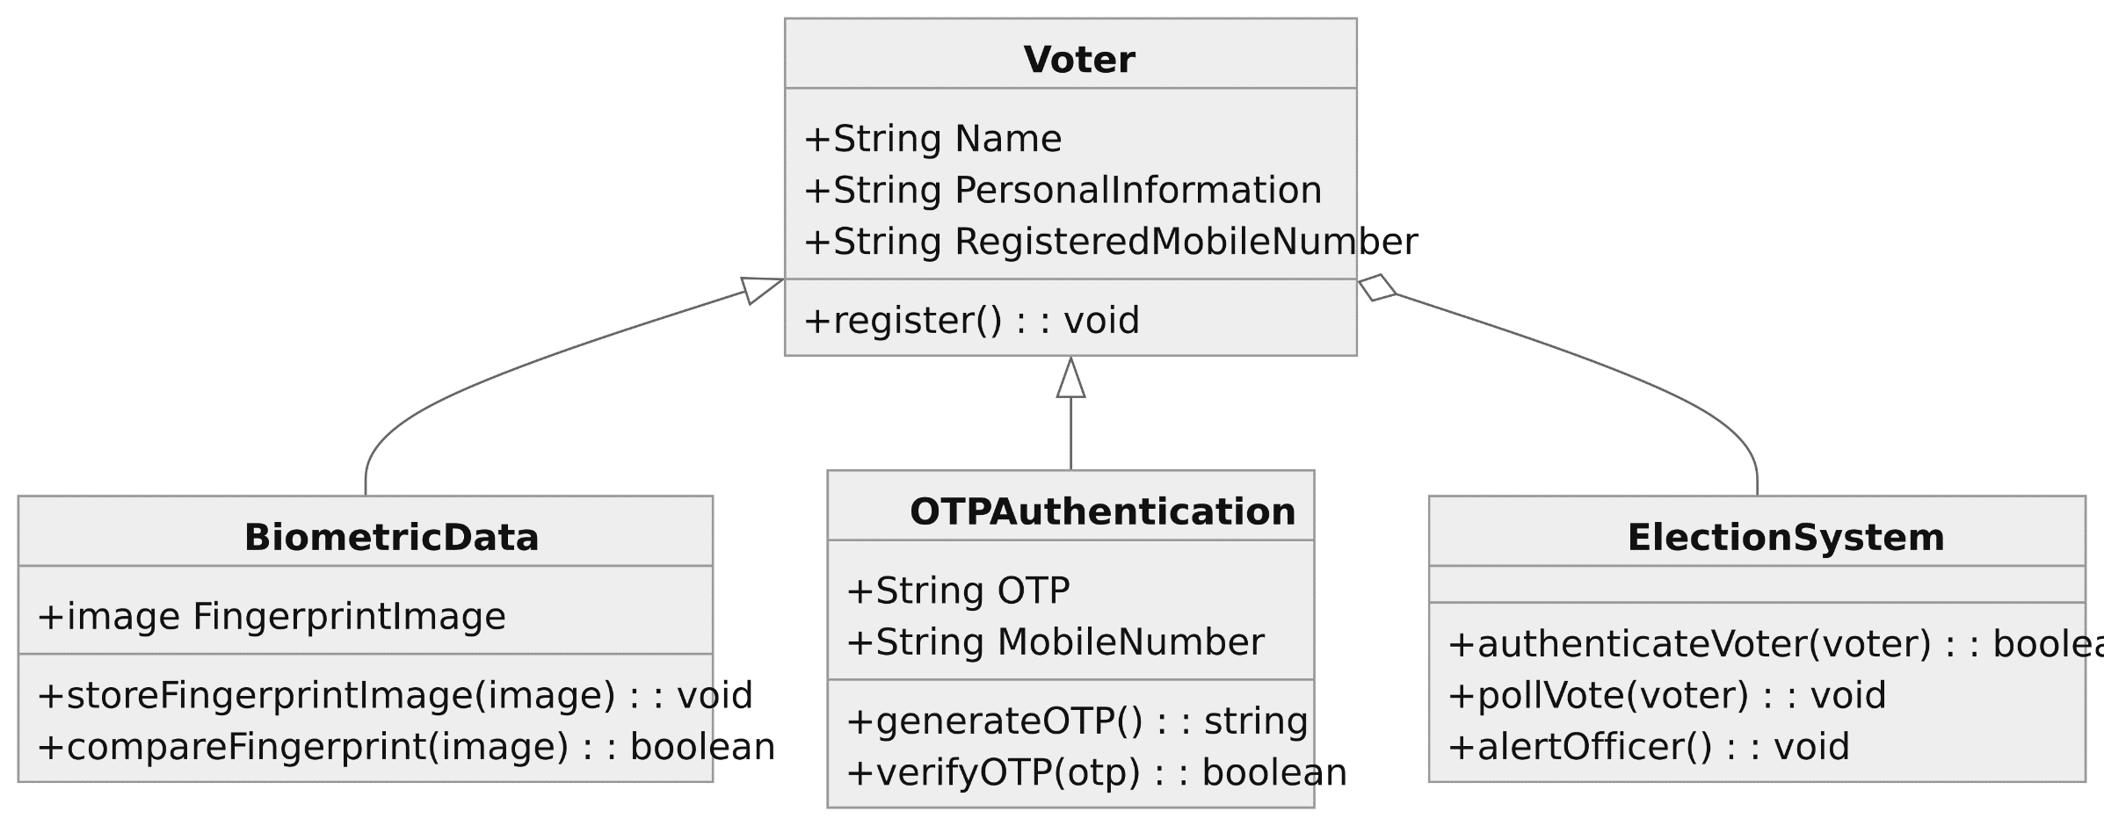
CLASS DIAGRAM

Slide 11
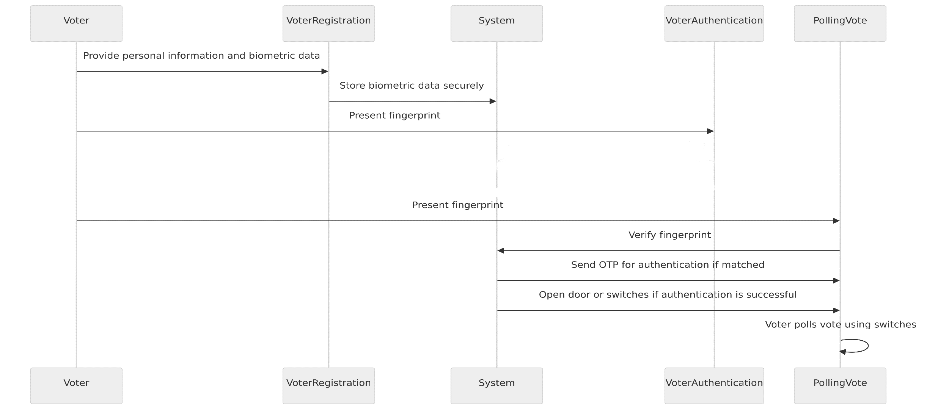
SEQUENCE DIAGRAM

Slide 12
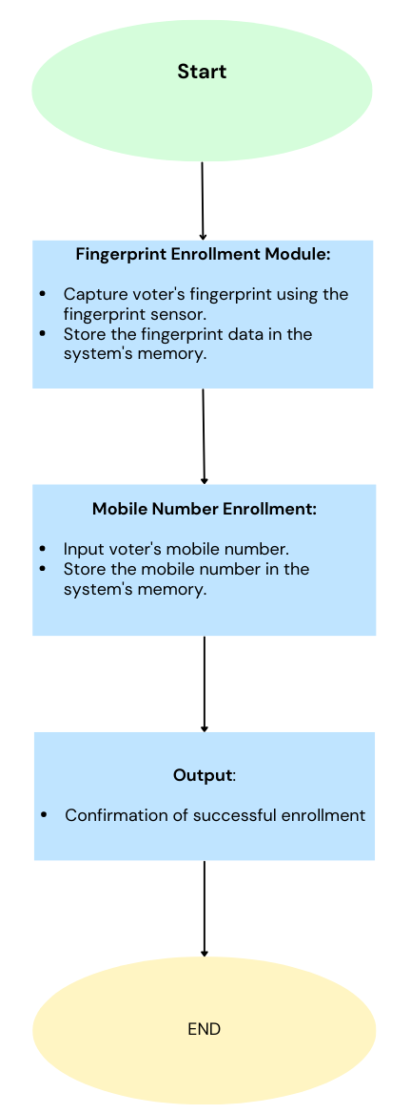
ACTIVITY DIAGRAM 1: ENROLLMENT

Slide 13
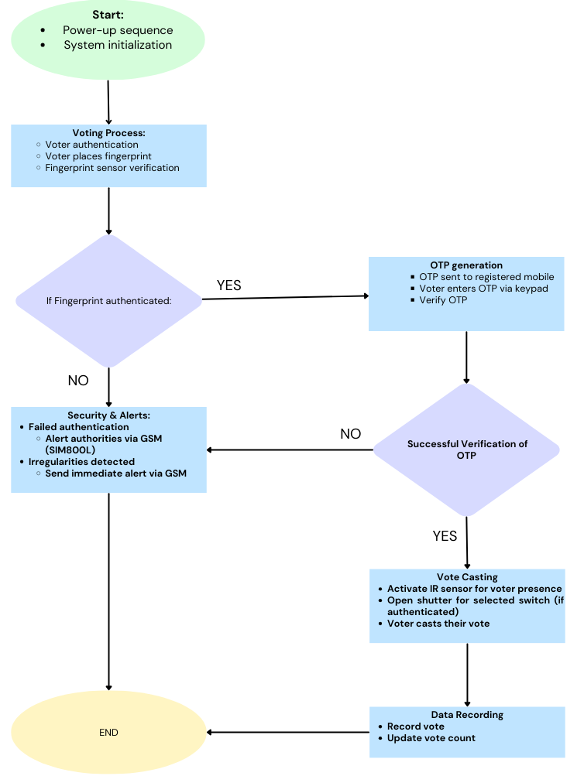
ACTIVITY DIAGRAM 2: VERIFICATION AND VOTING

Slide 14
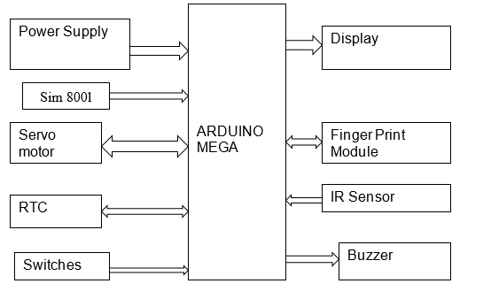
COMPONENT DIAGRAM
LCD Display
Johnson
UNO

Slide 15
BLOCK DIAGRAM 1: ENROLLMENT
Input
(Voter's fingerprint and mobile number)
Capture and stores voter's fingerprint using the fingerprint sensor.
Fingerprint Sensor Module
Stores the mobile number in the system's memory
Mobile Number Enrollment
System Memory
Confirmation of successful enrollment
Output

Slide 16
BLOCK DIAGRAM 2: VERIFICATION AND VOTING
Verify
ThingSpeak Cloud
(Node MCU)
Input
(Voter's fingerprint)
Fingerprint Verification
(Fingerprint Module)
Data Log only for Admin
If Matched
Access to vote and Recording of Vote
(Switches)
If not Matched
If Valid OTP
Alert
(Buzzer)
OTP Generation
(Arduino)
OTP Verification
(Keys, Arduino)
Sent to Mobile Via GSM
Sent to Mobile Via GSM
Output
Confirmation of successful vote casting
If Invalid OTP

Slide 17

METHODOLOGY
Requirement Analysis and System Design: Analyze project requirements and design system architecture.
Hardware Selection and Integration: Choose compatible hardware components and integrate them into the system.
Fingerprint Recognition Algorithm Implementation: Develop algorithms for fingerprint capture and matching.
GSM Communication Setup: Configure GSM module for mobile network communication.
OTP Generation and Verification Mechanism: Create algorithms for OTP generation and verification.
User Enrollment and Registration Process: Design system for enrolling voters' fingerprints and mobile numbers.
Testing and Validation: Conduct rigorous testing to validate system functionality.

Slide 18

IMPLEMENTATION
When a person wants to register himself in the voter list, he must provide his complete details along with his fingerprint image and phone number.
Thus, when the same person comes to poll his vote during the elections, he needs to give his fingerprint image before polling his vote. Thus, the system scans his fingerprint image, compares the image with the already stored image.

Slide 19
IMPLEMENTATION
If both the images are matched, an OTP will be generated to the number assigned to fingerprint and after successful OTP authentication the door to switches gets opened then Voter can poll his vote using switches.
If not, the system simply alerts Via buzzer to officer not allowing the voter to poll his vote. LCD is used to display the related messages.

Slide 20
PSEUDO CODE
Declare global variables:
Various pins for LCD, fingerprint sensor, motors, buttons, buzzer, etc.
Variables to store party votes, voter IDs, OTPs, mobile numbers, etc.
Define strings for SMS messages and IoT data.
Setup:
Initialize pins, LCD, and serial communication.
Initialize fingerprint sensor.
Verify fingerprint sensor connection and wait until verified.
Initialize GSM module for SMS communication.
Send AT commands to configure SMS settings and wait for network.
Register mobile number and send confirmation SMS.

Slide 21
PSEUDO CODE
3. Function to generate beep sound:
Turn on the buzzer for a specific duration and then turn it off.
4. Function to read keypad input:
Display "ENTER PASSWORD" on the LCD.
Use buttons to enter a password (OTP) and validate it.
Return the entered password.
5. Main loop:
Continuously check for button presses to perform actions.
If button 'b1' is pressed, enroll a fingerprint.
If button 'b3' is pressed, identify the fingerprint.
If a fingerprint is identified, proceed with voting process.

Slide 22
PSEUDO CODE
6. Voting Process:
Determine the person based on the fingerprint ID.
Generate and send OTP to the registered mobile number.
Prompt the user to enter OTP using the keypad.
Verify the entered OTP with the generated OTP.
If OTP is valid, allow the person to vote by pressing buttons 'b1', 'b2', or 'b3'.
Increment the corresponding party's vote count.
Send a thank you SMS to the voter's mobile number.
Update data with voting information.
7. Error Handling:
If an invalid OTP is entered, blow the buzzer.
If the fingerprint ID is not recognized, notify the user and wait for a valid fingerprint.
If any error occurs during GSM communication, retry or notify the user.

Slide 23
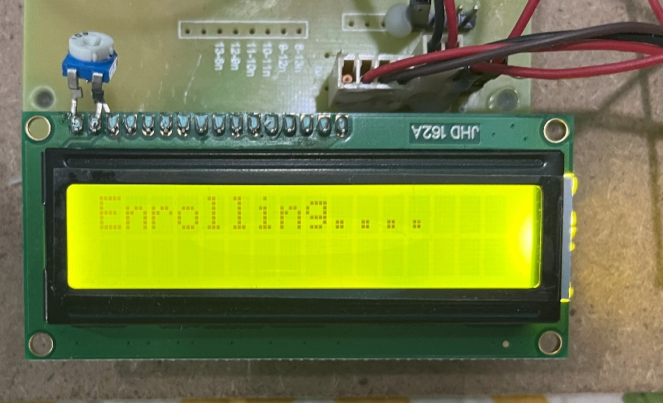
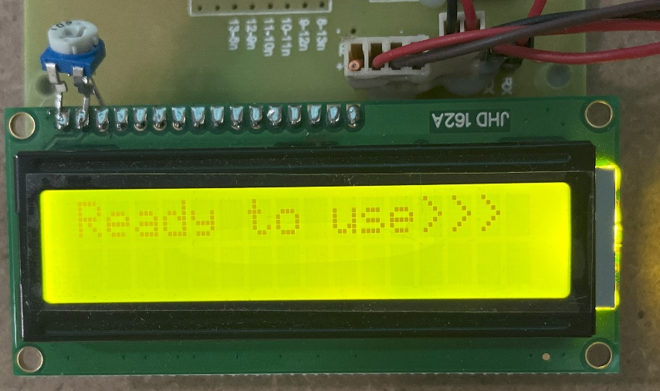
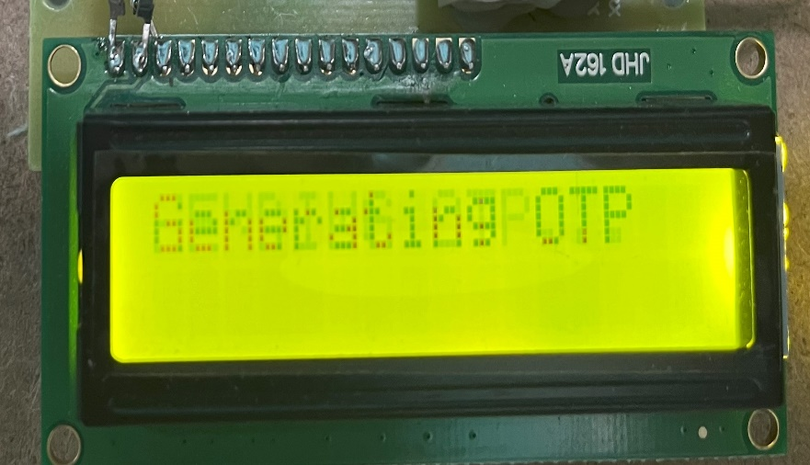
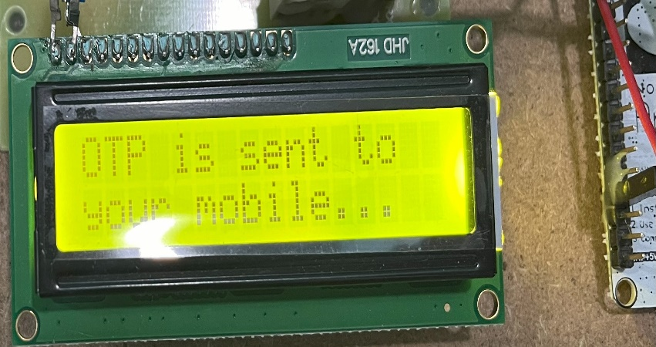
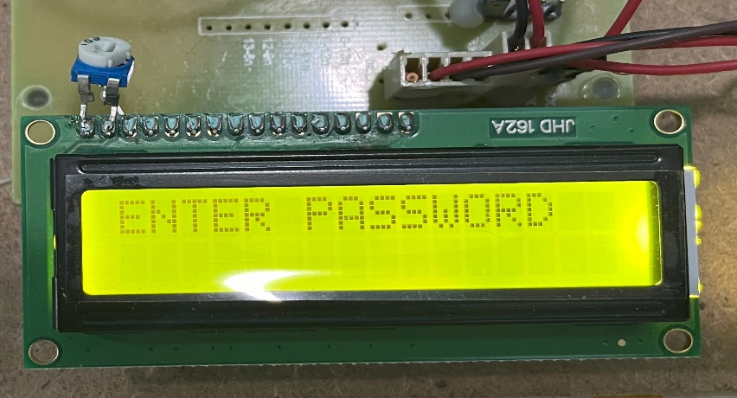
Screenshots

Slide 24
FUTURE ENHANCEMENTS
Integration of blockchain technology: Enhance transparency and immutability of voting records.
Implementation of facial recognition: Supplement biometric authentication for additional security.
Mobile application support: Develop a dedicated app for voter registration and authentication.
Multi-factor authentication: Incorporate additional authentication methods for heightened security.
Scalability improvements: Design the system to accommodate larger voter populations and diverse electoral processes.

Slide 25

CONCLUSION
Our Voting System presents a robust solution to the challenges faced by traditional voting systems.
The main objective as stated before is to enhance the security to prevent duplication, efficiency, accessibility and provide a system which reduce the burden for people on conducting a voting. Thus, by implementing this system, user can put their vote with fingerprint instead of paper without doubting about their security.
By leveraging biometric technology and mobile communication, we've developed a secure and efficient platform that enhances the integrity of the voting process. With its potential to prevent fraud and ensure accurate authentication of the voter, this system represents a significant step forward in modernizing electoral procedures.

Slide 26


